Slide 1
Session Overview
Hypothesis testing - what is it and why do we do it?
What is the theory involved in hypothesis testing?
The steps to take to test an hypothesis
Tests we can run on our data experiments
Errors and Uncertainty, Type I and Type II Errors
Diving into the p-value
Q & A

Slide 2
Key Takeaways
You will know what hypothesis testing is and how to perform your own hypothesis testing
You will have an understanding of the terminology and also the variables used to perform hypothesis testing
You will know which Python language tools you can use to run your own hypothesis tests
You will have a roadmap of which tests you can run based on your data
You know how to avoid making errors associated with hypothesis testing

Slide 3
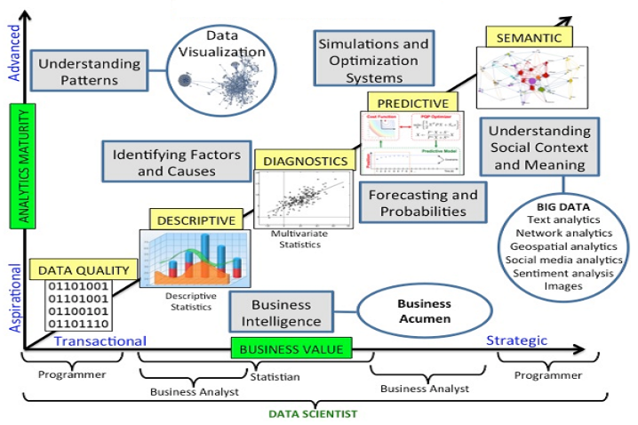
Hypothesis Testing and Data Science?

Slide 4
Hypothesis testing - what is it?
It’s a guess about something in the world around us
It is a guess that we can test.
We state the guess in two ways:
one that specifies the general understanding of what to expect in a result,
the other our own alternative guess about the result, based on observation or our experimental plan
We measure the outputs of an experiment or sample of the thing we are guessing about.
We test our measurements using appropriate statistical tests and draw our conclusions

Slide 5
Setting Up and Running An Hypothesis Test
How do we do it? By:
Writing down the hypotheses, notably the null hypothesis, which is the opposite of the hypothesis we want to prove (with a certain degree of confidence).
Computing a test statistic, a mathematical formula depending on the test type, the model, the hypotheses, and the data.
Using the computed value to reject the hypothesis with a given level of uncertainty, or fail to conclude (and, consequently, accept the hypothesis until future studies reject it).
Some examples of hypotheses:
I think this coin is biased and will land on heads more often than a fair coin;
medicine A will help people recover from influenza faster than medicine B;
giving a child a tablet computer reduces their reading skills

Slide 6
Some Definitions...
Some terminology
Data typology
Sampling and data distribution
Assumptions
Limitations

Slide 7
Fundamental Terms
Population - the number of things we are measuring. We want to build meaningful insights about the population.
Sample - either all or a subset of the population, n
Mean - average of the value we’re examining, in the sample, ͞͞x
Expected likelihood of null hypothesis - our expected probability - ｑ
Variance, the expectation of the squared deviation of a random variable from its mean. In this case it relates to the distribution we use to test against, e.g. 𝝈² = ｑ(1-ｑ) if we use a Bernoulli distribution (coin flip example)
Variance of the mean: 𝝈²/n
Standard deviation of the distribution, or, how the values disperse from the mean

Slide 8
Some examples of Stating Hypotheses
A hypothesis is an educated guess about something in the world around you. It should be testable, either by experiment or observation. For example:
A new medicine you think might work.
A way of teaching you think might be better.
A possible location of new species.
A fairer way to administer standardized tests.
https://www.statisticshowto.datasciencecentral.com/probability-and-statistics/hypothesis-testing/

Slide 9
What is a Hypothesis Statement?
If you are going to propose a hypothesis, it’s customary to write a statement. Your statement will look like this:
“If I…(do this to an independent variable)….then (this will happen to the dependent variable).”
For example:
If I (decrease the amount of water given to herbs) then (the herbs will increase in size).
If I (give patients counseling in addition to medication) then (their overall depression scale will decrease).
If I (give exams at noon instead of 7) then (student test scores will improve).
If I (look in this certain location) then (I am more likely to find new species).
https://www.statisticshowto.datasciencecentral.com/probability-and-statistics/hypothesis-testing/

Slide 10
Computing Test Statistics
We compute test statistics chosen by considering our experiment and dataset. We then use the test statistic to tell if we got our result by random chance or if results could be actually valid.
Can we find a fact that we will disprove or reject? E.g. Fair coin flips have an equal chance of landing on heads or tails; medicine A will not help a cold-sufferer recover faster than medicine B; a child given a tablet computer will score the same on reading comprehension tests as a child without a tablet computer.
What is the null-hypothesis for the coin flip experiment?.
What does the Z-test look like in Python?
Now let’s work through #Notebook 1

Slide 11
What Is The Logical Flow Here?
We assumed that, if we flipped a coin many times, the number of heads and number of tails would add up to a particular count pattern or distribution. In this case the Bernoulli distribution, a kind of Binomial distribution - the bell curve.
We then calculated the odds of 61 out of 100 coin flips occurring by chance. Or, if the null hypothesis were true of our coin flips, what is the chance of 61/100 heads flips happening at random?
A generally accepted likelihood of something being significant is if its likelihood is less than 5% or 0.05. So, a p-value < 0.05 means either
The null hypothesis is false, so we conclude that the coin is biased.
The null hypothesis is true, and it's just bad luck or pure chance we obtained these values. We cannot make a conclusion.
We generally accept a) but this still doesn’t guarantee significance. It is likely, but NOT guaranteed.

Slide 12
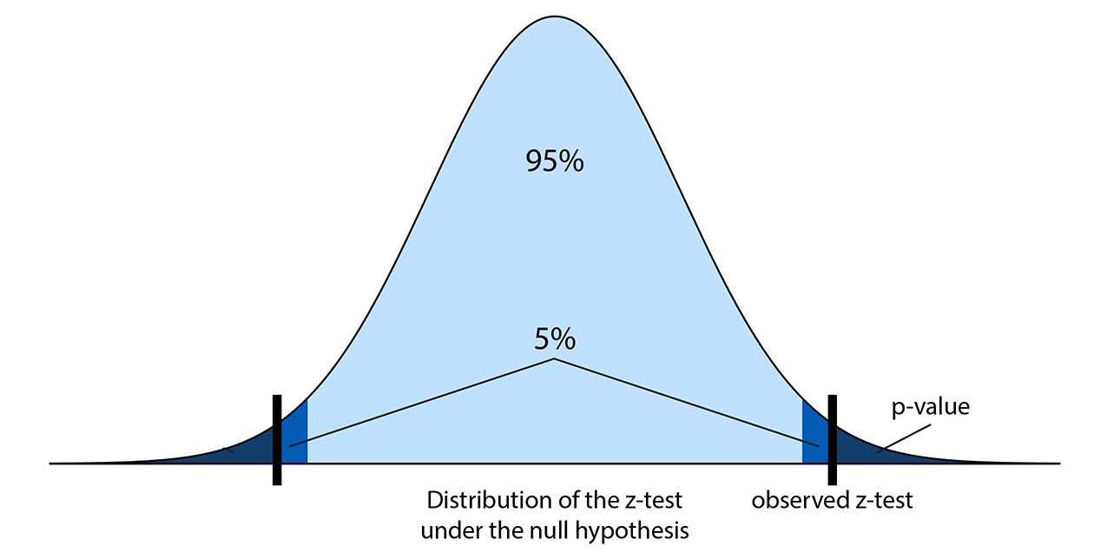
Graphical Representation of p-value
https://ipython-books.github.io/72-getting-started-with-statistical-hypothesis-testing-a-simple-z-test/

Slide 13
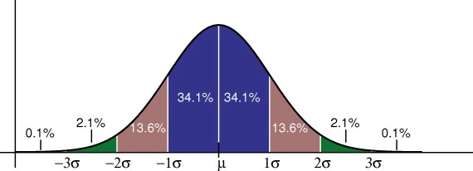
Some More Statistics Terminology
Population, sample, probability distribution

Slide 14
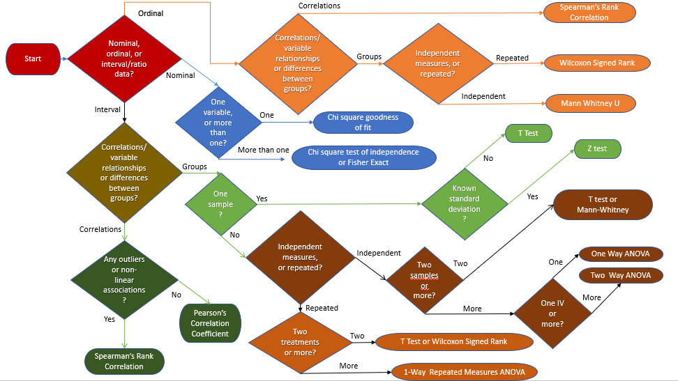
Some Guidance on Choosing a Test Statistic
https://www.datasciencecentral.com/profiles/blogs/hypothesis-tests-in-one-picture

Slide 15
The p-value and Errors
When using any statistical test, however, there is always the possibility that you will find a difference between groups when one does not actually exist. This is called a Type I error.
Likewise, it is possible that when a difference does exist, the test will not be able to identify it. This type of mistake is called a Type II error.
How do we know when we have made either of these errors? We need to know more, bringing us to statistical power.

Slide 16
Statistical Power
… statistical power is the probability that a test will correctly reject a false null hypothesis. Statistical power has relevance only when the null is false.
The Essential Guide to Effect Sizes: Statistical Power, Meta-Analysis, and the Interpretation of Research Results, Ellis, P, 2010.
As sample size increases, the power of the test to discriminate increases. We need to know if we have sampled more than a minimum to be confident we are avoiding Type I or II errors.
How much power is enough? This brings us to the concept of effect size.
Statistically significant results mean only that there is a difference between our hypothesis and the null hypothesis. They don’t mean we’ve found anything important or of large influence.
Statistically significant results mean only that you can be confident that there is a difference.

Slide 17

Calculating Effect Size
𝞵₁ - mean of treatment group
𝞵₂ - mean of control group
𝝈 - standard deviation of control group
𝜃 - effect size
The resulting number is often interpreted as follows [Cohen]:
< 0.1 = trivial effect
0.1 - 0.3 = small effect
0.3 - 0.5 = moderate effect
> 0.5 = large difference effect

Slide 18
Tying Statistical Power and Effect Size Together
For any power calculation, you will need to choose:
Statistical test to use (e.g., independent t-test, paired t-test, ANOVA, etc.)
The alpha (𝝰) level or significance level to be used (usually 0.05, sometimes 0.01).
The expected effect size,
The sample size you are planning to use
Effect size can only be calculated after collecting data, so we start initially with a chosen value, generally 0.5 - moderate effect.
Power is a number between 0 and 1. Less than 0.8 means the sample size must be increased.
#Notebook Cell 2

Slide 19
Bibliography
https://machinelearningmastery.com/statistical-hypothesis-tests/
https://ipython-books.github.io/
http://meera.snre.umich.edu/power-analysis-statistical-significance-effect-size
https://www.statsmodels.org/dev/stats.html#basic-statistics-and-t-tests-with-frequency-weights
https://www.statisticshowto.datasciencecentral.com/probability-and-statistics/hypothesis-testing/
https://www.statisticsdonewrong.com/

